Slide 1

Review of Climate Change Impact on Water Resources
IWME 502
NISHTHA CHAWLA

Slide 2
AGENDA
Background
Relation b/w Climate Change & Water Resources
Research Methods
Examples
Comparison
Uncertainties
Adaptation
Issues & Challenges

Slide 3

BACKGROUND
Effect of Climate Change:
1. Water Quality
2. Water Resource Distribution
Notes:
The effects of climate change is multi-scale, all-round, multi-level, both positive and negative effects. Climate change not only affects the hydrological, biological and ecological system, but also affects the economy
According to the Intergovernmental Panel on Climate Change (IPCC AR5, 2014), the global mean temperature may increase up to 4 °C by 2100, and will severely affect the availability of water resources and the water demand across the world
Climate change will change water quality due to change in temperature and rainfall.
Climate change will redistribute water resources in time and space.
This will cause the human society and ecology to change

Slide 4
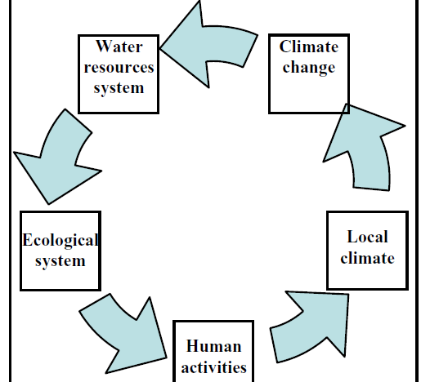
Relation b/w Climate & Water Resources
Increased Precipitation Intensity
Higher surface Runoff
Increased Flood Risk
Less Groundwater Recharge
High Evapotranspiration
Increased Irrigation water demand
Notes:
The climate system, directly or indirectly affect the process of water circulation by precipitation, temperature, sunlight, wind, humidity and other factors.
Increased intensities of precipitation will lead to higher rates of surface runoff, an increased risk of flood and decreased rates of groundwater recharge.
Rise in temperature causes higher evapotranspiration, and, in turn, further enhances the demand for irrigation water, by far already the biggest water consumer under present conditions.

Slide 5
Research Methods
(1) Define climate change scenarios
(2) Establish, verification of hydrologic model
(3) Make the climate change as input to model & simulate change process
(4) Use simulation results of hydrologic model to evaluate the climate change on the influence of hydrology and water resources.
GHM- Global Hydrological Model
GHG- Greenhouse Gas Emission
GCM- General Circulation Model
RCM- Regional Climate Model
Through the basin temperature, precipitation and evaporation change caused by climate change
Notes:
The research of the impact of climate change on hydrology and water resources system is mainly through the basin temperature, precipitation and evaporation change caused by climate change such as to predict the trend may increase or decrease the runoff and its watershed water supply influence. Using the
“what-if-then” pattern
The pattern often include the following 4 steps:(1) Define climate change scenarios; (2) Establish, verification of hydrologic model;
(3)Make the climate change) hydrologic model of the scene as input and simulate the change process of internal water circulation; (4) Using the simulation results of the hydrologic model to evaluate the climate change on the influence of hydrology and water resources.
General Circulation Models (GCMs) are often used for understanding the climate dynamics and projecting future climate change.

Slide 6
Example 1: Koshi River Basin, Nepal
Goal: Assess changes in the hydrological regime of the Koshi River Basin with & without climate change using the Soil and Water Assessment SWAT Tool
Flow: Combination of snow melt runoff and rainfall
Feature: high rainfall receiving zone
Findings:
Climate change is less likely to pose the threat on average water availability
Any design based on a 100-year design flood flow (57,900 m3/s) may need to be changed to a design flood flow for a return period of more than 1000 years
Flow is decreasing during the lean season and increasing during the high flow season
Notes:
-the mean annual temperature of Nepal is expected to increase by 1.4◦C by 2030, 2.8◦C by 2060
-Increased temperature leads to greater evaporation and thus surface drying which thereby increases the intensity and duration of drought. the water holding capacity of air increases by about 7% per 1◦C warming which leads to increased water vapor in the atmosphere. It consequently, produces more frequent and intense precipitation events
It was concluded that any design based on a 100-year design flood flow (57,900 m3/s) may need to be changed to a designflood flow for a return period of more than 1000 years, when based on historical data (47,445 m3/s), in order to account for the impact of climate change

Slide 7
Comparison: Thames River Basin of Canada
Results of fifteen different climate models
Future conditions in 2020, 2050 and 2080.
Findings:
The 100-year and 250-year flood magnitudes were found to be respectively 12% and 32% higher than baseline
Negligible impact for the 10-year return period
Conclusion: flood flow increase under climate change impact, with higher changes for higher return periods.
Notes:
the impact of climate change in a given basin depends on the land-use in the specific basin
Das and Simonovic (2012) conducted a study to assess the impact of climate change to assess in the upper Thames River Basin of Canada using the results of fifteen different climate models for the future conditions in 2020, 2050 and 2080.They stated that the 100-year and 250-year flood magnitudes were found to be respectively 12% and 32% higher than for the baseline period (1979–2005) with negligible impact for the 10-year return period. It indicates that the magnitudes of flood flow increase under climate change impact, with higher changes for higher return periods

Slide 8
Example 2: Kharun Catchment, India
Goal: Assess impact on water balance component
Flow : Dependent on Monsoon Rain
Feature: Severe Water Stress, Core of Agro-economy
Simulations: SWAT Soil and Water Assessment Tool
Finding: Indicate over-proportional runoff-rainfall and under-proportional percolation rainfall relationships.
 | 2020 | 2050
Discharge | decrease by 2.9% | increase by 12.4%
Surface RunOff | decrease by 0.7% | increase by 14.6%
Water Yield | decrease by 2.5% | increase by 12.8%
Notes:
Discharge (m3/s): decrease by 2.9%, increase by 12.4%
Surface Runoff: decrease by 0.7% , increase by 14.6%
Water Yield: decrease by 2.5%, increase by 12.8%
It is expected that the impacts of future climate change will be severe in the UKC, because its economy largely depends on agriculture
a rather high increase in discharge can be expected which will enhance the risk of floods in low lying areas, whereas the recharge (via percolation) remains nearly constant.

Slide 9
Comparison
Goal: Monthly rainfall observations for linear trends across 36 climatological regions (representing different parts of India) during the period 1901–2003
Findings: 8 regions showed significant increases
Any change in the climate would have a significant impact on the agricultural production,
Other Issues: Stress due to high population growth rates and problems related to water resources management
Notes:
Guhathakurta and Rajeevan (2008) performed monthly rainfall observations for linear trends across 36 climatological regions (representing different parts of India) during the period 1901–2003
whereas 8 regions showed significant increases

Slide 10
Example 3 – Peribonka River System, Quebec, Canada
Findings: Reduction in mean annual hydropower production from -12 % to + 2%
Increase in spills, temp & precipitation
Increase in the annual average inflow to the reservoirs
Reservoirs would be less reliable and more vulnerable
Conclusion: power plant managed with a reservoir is sensitive to the operating rules
Rules should be re-examined in order to take account of new seasonal hydrological contexts
Notes:
for the Peribonka water resource system _Quebec, Canada_ the tendency is for a reduction in mean annual hydropower production and an increase in spills, despite an increase in the annual average inflow to the reservoirs
In general, the projections indicate an increase in annual inflow earlier peaks and greater volumes during the spring flood. The analyses show that a power plant managed with a reservoir is sensitive to the operating rules and that these rules should be re-examined in order to take account of new seasonal hydrological contexts

Slide 11
Uncertainties
Source: Uncertainties in the climate impact on water resources result from natural complexity and variability of systems and processes, and from deficiencies in our knowledge and models.
Method: Sensitivity analysis, Scenario analysis, ANOVA method
Uncertainties because of the gaps in knowledge and insufficient understanding of the complex processes and their feedbacks and interconnections
Notes:
There are uncertainties everywhere in modelling and acknowledging them is important
Uncertainty can be involved in the input data due to data scarcity, measurement errors
Uncertainty in projections of climate change impact on water resources is due to: (i) scenarios of future socio-economic development, (ii) GHG emission and sequestration scenarios, (iii) General Circulation Models, GCMs, (iv) Regional Climate Models, RCMs
uncertainties because of the gaps in knowledge and insufficient understanding of the complex processes and their feedbacks and interconnections

Slide 12
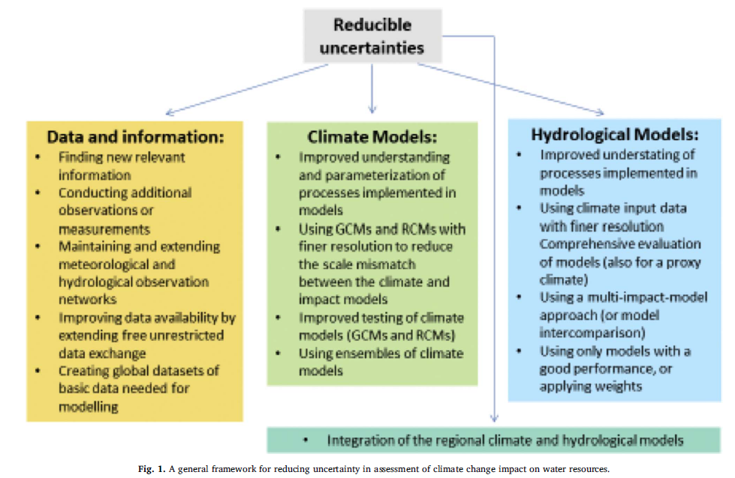
Uncertainties
Reducible!
Notes:
Uncertainty may be reduced by the act of obtaining more exact information (by way of finding a relevant new fact, conducting additional observations or measurements
Critical problems are related to data availability and understanding of processes encapsulated in climate and hydrological models. The emerging availability of global datasets and remote sensing data enables model intercomparisons, and may lead to uncertainty reduction
Here is a framework for reducing uncertainty in assessment of climate change impact on water resources

Slide 13
Adaptation
Development of water storage systems
Irrigation of bioenergy crops
Cooling technologies for electricity generation
Additional facilities and strategies to increase the storage capacity of the landscape
Combine technical facilities (reservoirs, infiltration sites) and land management practices
Notes:
Additional facilities and strategies to increase the storage capacity of the landscape should be considered.
Irrigation of bioenergy crops and cooling technologies for electricity generation are among the most influential factors affecting future water demand in the context of climate change mitigation
Respective concepts could combine technical facilities (reservoirs, infiltration sites) and land management practices towards enhancing landscape storage.
Detailed consideration of the land use type, crop rotation and irrigation amount while estimating the impact of climate change is the option to conceive targeted recommendations on land use management which are appropriate to counterbalance the impact of climate change on the water balance.

Slide 14
Issues
No direct use of Climate Model in Water Management Sector & Infra Planning
Uncertainty about future water demand
Irregular distribution pf precipitation
Developing countries are more vulnerable to extreme weather events
Difficult to predict GHG emission & CC effect in deterministic way
Notes:
climate models cannot be directly used in the realm of many real-world applications in the water management sector and infrastructure planning and design.
On the top of uncertainty related to future water availability, there is a considerable uncertainty about future water demand.
The irregular distribution of precipitation in space also leads to notable disparities in water availability between different territories, aggravating the situation concerning water management.
Uncertainty is essentially because anthropogenic greenhouse gas emission as well as some climate change effects and feedbacks cannot be predicted
in a deterministic way

Slide 15
Possible Positive Effects
Longer growing seasons in cool countries
More efficient shipping routes through an ice-free Arctic
Global agricultural productivity may increase during the first three degrees
Longer summer shipping season will generate more economic opportunities for Nunavut
Climate change from 2005 to 2050 in North Cameroon or Madagascar will have a positive effect on both cotton and rice yields
Fewer winter deaths
Notes:
Good news is no news, which is why the mainstream media largely ignores all studies showing net benefits of climate change. And academics have not exactly been keen to push such analysis forward.
global agricultural productivity may increase during the first three degrees Celsius of warming, driven by gains in relatively wealthy high-latitude regions
For example, decreasing ice could allow increased shipping through Arctic waterways, including the Northwest Passage. While this may mean economic benefits for Nunavut, it can also raise the risk of oil and chemical spills
The chief benefits of global warming include: fewer winter deaths; lower energy costs; better agricultural yields; probably fewer droughts; maybe richer biodiversity. It is a little-known fact that winter deaths exceed summer deaths — not just in countries like Britain but also those with very warm summers, including Greece

Slide 16
Thankyou!
Questions?

Slide 17
Papers Covered
S.No | Title
1 | A global assessment of the impact of climate change on water scarcity
2 | Impact analysis of climate change on water resources
3 | Uncertainty in climate change impacts on water resources
4 | Analyzing climate change impacts on water resources under uncertainty using an integrated simulation-optimization approach
5 | Impact of climate change on water resources of upper Kharun catchment in Chhattisgarh, India
6 | Adaptation to climate change impacts on water demand
7 | Impacts of climate change on hydrological regime and waterresources management of the Koshi River Basin, Nepal
8 | Impacts and Uncertainty of Climate Change on Water Resource Management of the Peribonka River System Canada…
9 | Uncertainty in climate change impacts on water resources in the Rio Grande Basin, Brazil
10 | Climate change impact on water resources availability – Case study of the Llobregat River basin (Spain)

